Slide 1

Spring Semester 2026
Greek Literature in the Era of the
Atheno-Peloponnesian Wars (431–404 BCE)
Ion of Chios (II)
Prof. Dr. Ruobing Xian

Slide 2

Contents
Ion’s Epidēmiai as a Literary Forerunner
The Sympotic Settings of Ion’s Epidēmiai
Ion in Plutarch’s Lives

Slide 3
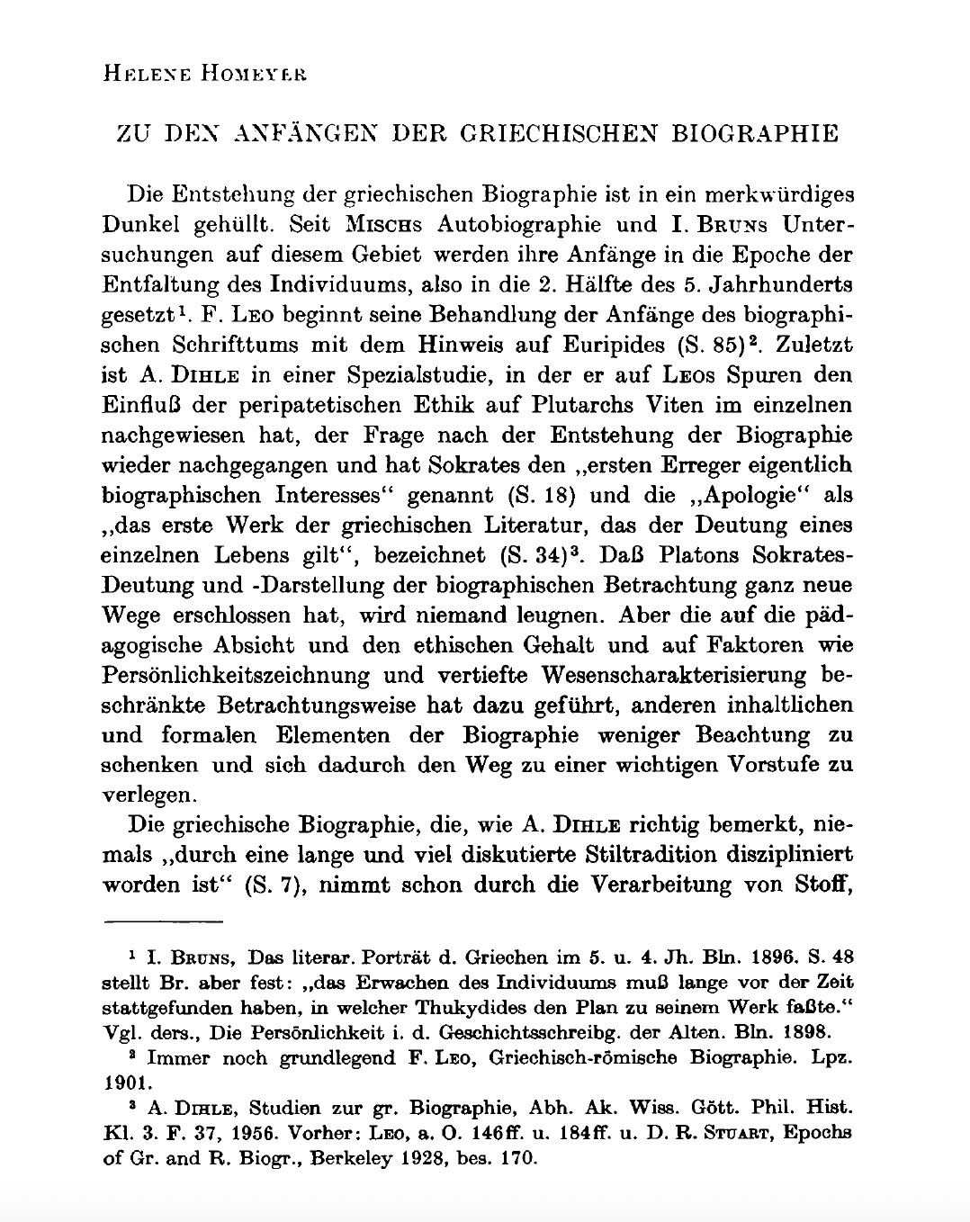


Ion’s Epidēmiai as a Literary Forerunner

Slide 4
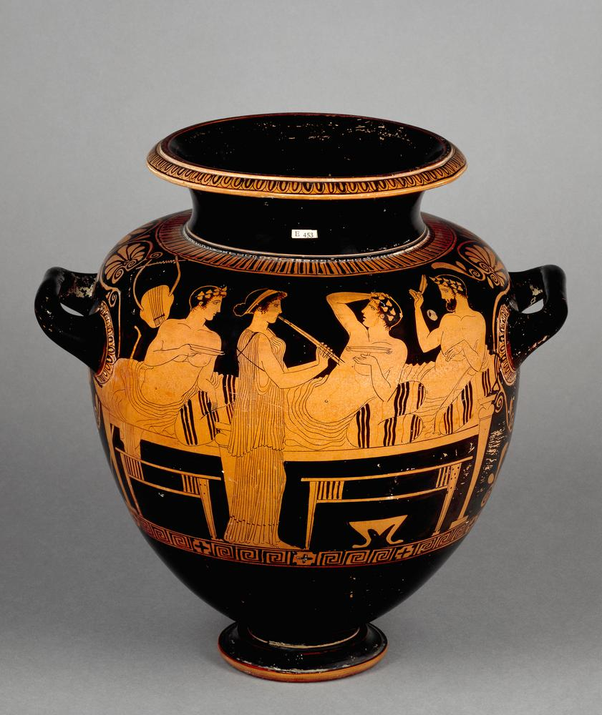
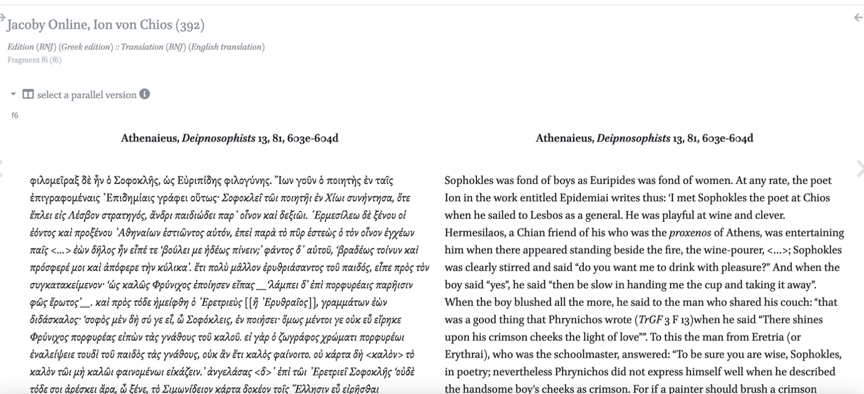
The Sympotic Settings of Ion’s Epidēmiai

Slide 5

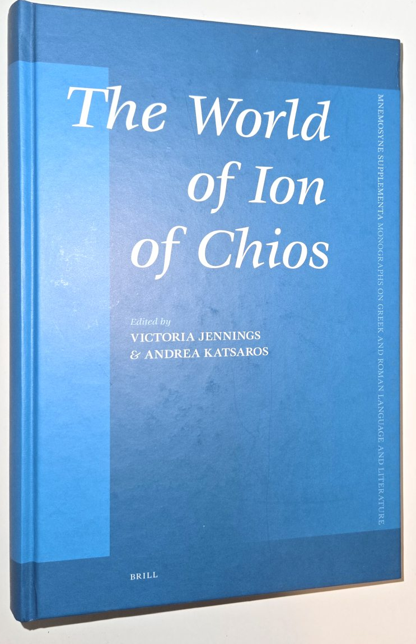
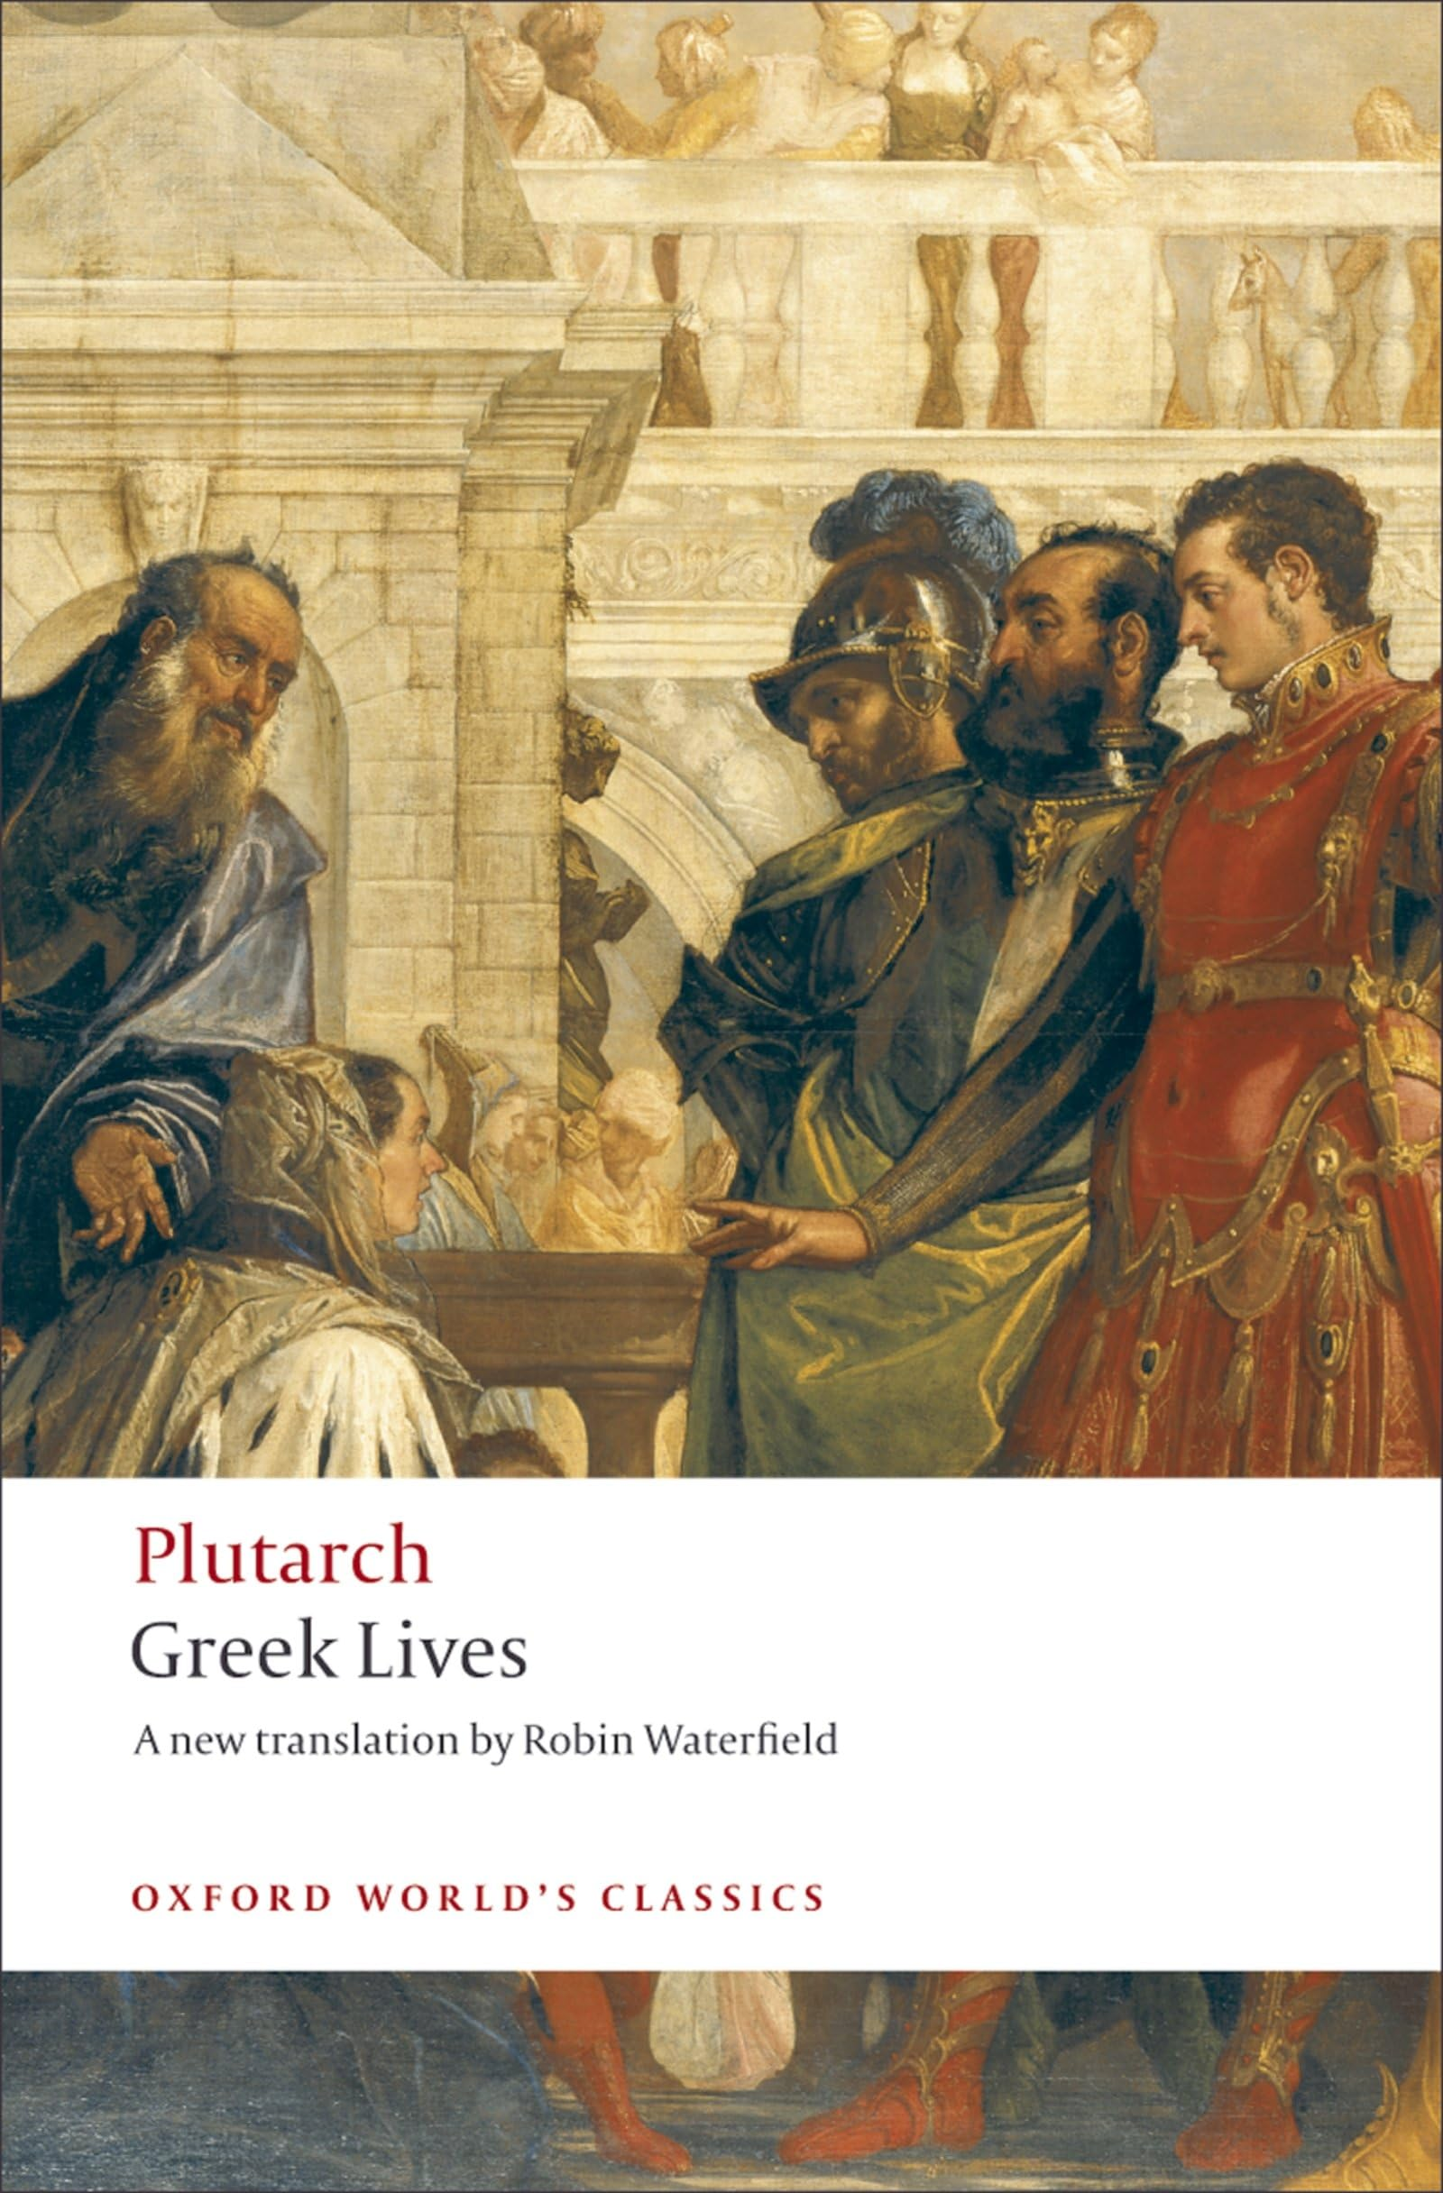
Ion of Chios in Plutarch’s Lives

Slide 6
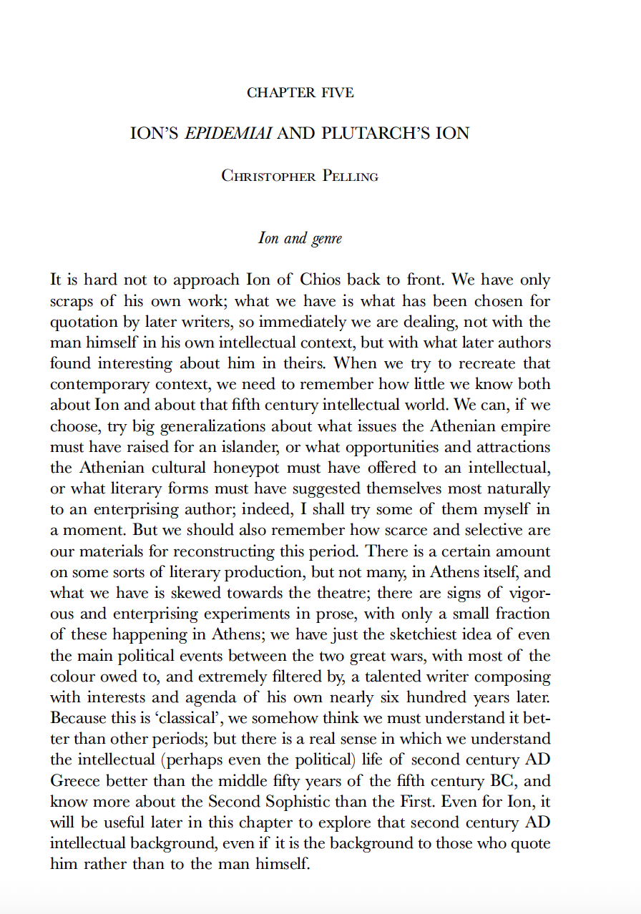
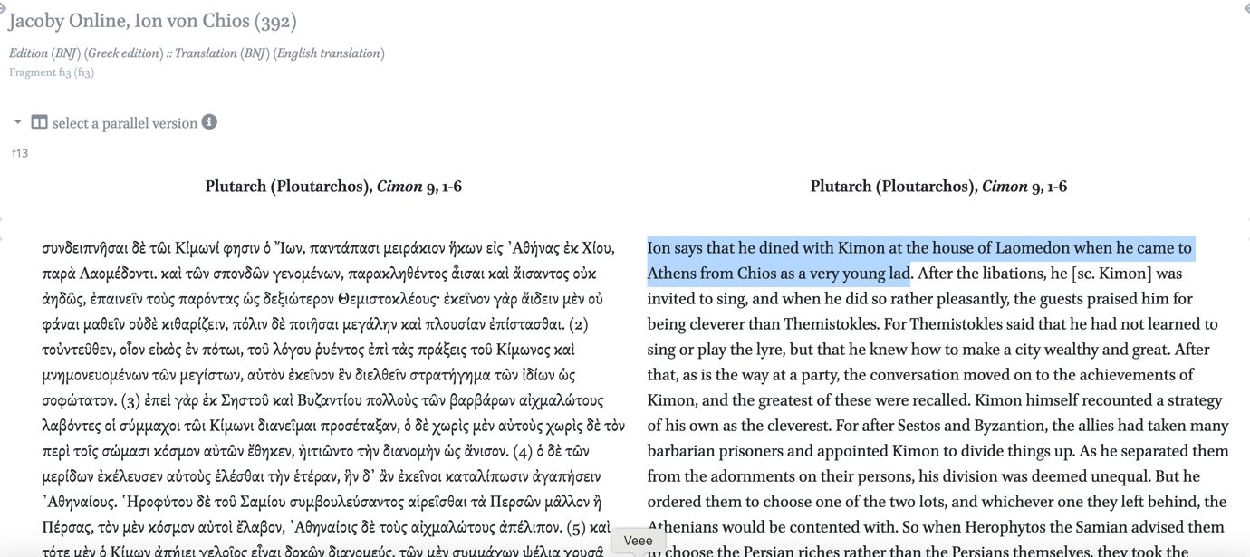
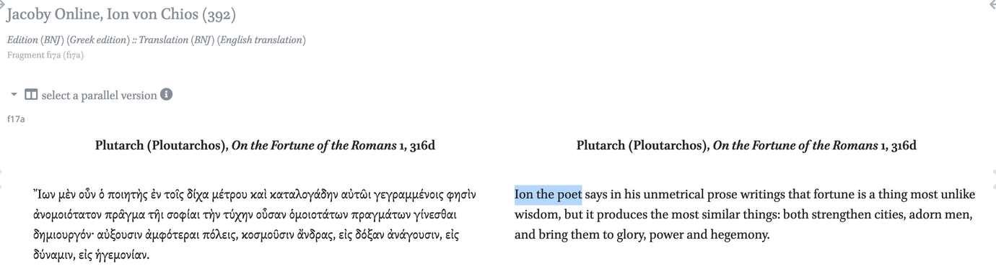
‘Ion of Chios’ and ‘Ion the Poet’

Slide 7
Thanks for your attention!
Contact: ruobingxian@fudan.edu.cn

